Slide 1


Prediction of Flight Delay
Jean Louis Jonilyto

Slide 2
Table of contents :
Introduction
Data
Data Preprocessing
Methodology
EDA
Modeling
5. Conclusion

Slide 3

Project Description
This is Shito.
Shito is a CEO of a multi-national company, he has to travel regularly, and has to fly a lot, his biggest problem is being late for his appointments since every second he is late can be a big problem. Because of this he asked me to do a study on different airports and to tell which ones have the reputation of being on time.

Slide 4

A company, which constantly has delays in its flights either on departure or arrival, could lose its customers or contracts, because a customer who is not satisfied with its services is almost lost, the loss of customers results in a decrease in revenue. The primary objective of a company is to maximize its profits while satisfying the needs of its customers, a need to move and arrive on time without any problem.
This project, I have carried out primarily for airlines who wish to optimize their delays in order to better manage their services, with the goal of increasing the confidence and loyalty of their customers. Secondly, this project affects travellers who want to know the best time according to their requirements to travel without expecting too many flight delays.

Slide 5

In my work, I will try to, over a period of about three years :
*1) Look at the number of flights made through Haiti that will be divided into delays and non_delays while grouping them by :
* A) Company
* B) Time
* C) Day
* D) Month
* E) Quarter
2) With the Learning Machine to predict flight delays,verification of the accuracy of the prediction as well as the ROC curve.

Slide 6
Data
The data used for the realization of this project can be found at the following address https://www.flightera.net/fr/airport/Port-au-Prince/MTPP/arrival.
and the way to get them is in this notebook.
https://github.com/Shito3/Airplanes_Analysis

Slide 7
EDA
The methodology in this project consists of two parts:
-Exploratory Data Analysis: Consists of visualizing air traffic per day
- Modeling: With the Learning Machine to predict flight delays

Slide 8
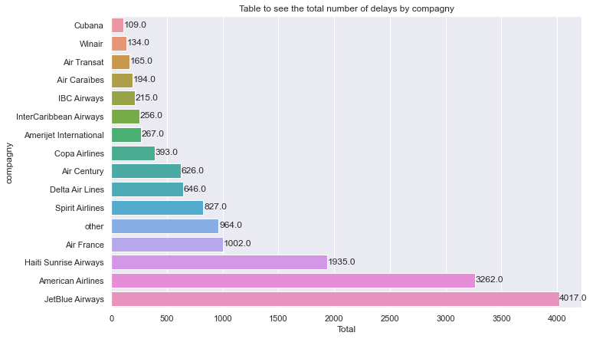
EDA
This graph shows the total number of flights of each company.

Slide 9
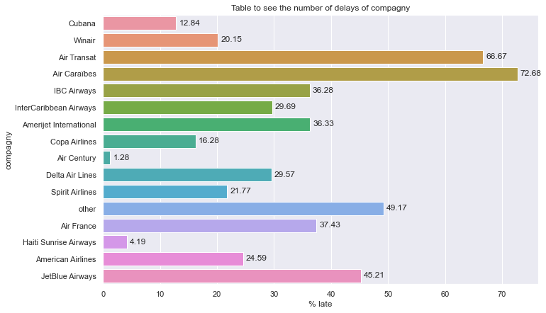
EDA
We can notice that the majority of airlines that make fewer flights are more likely to produce delays

Slide 10
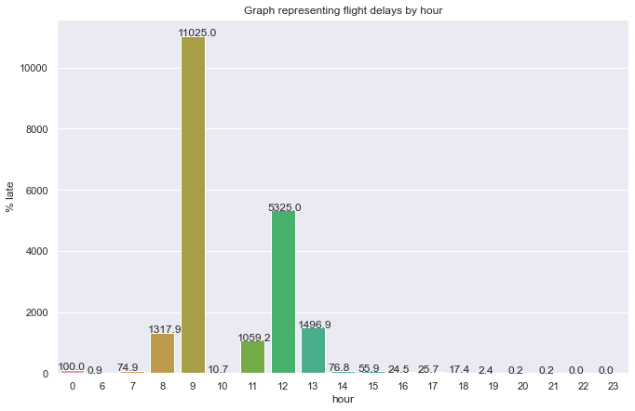
EDA
This graph shows the number of flights per hour.
Peak flight times are 9:00 a.m., noon, 1:00 p.m. and 8:00 a.m.

Slide 11
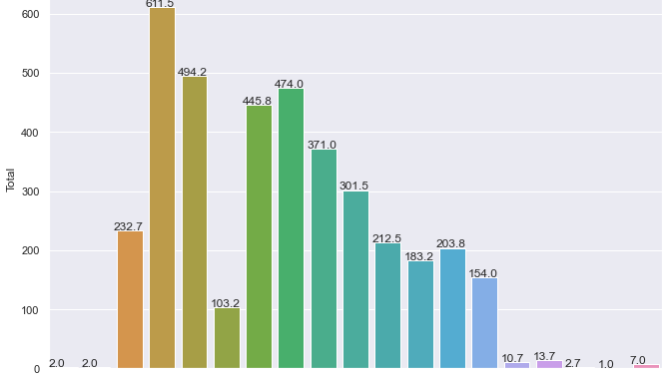
EDA
Many flights are operated at around eight, nine and eleven o'clock at two o'clock, yes, but around nine and twelve o'clock there are a lot of delays.

Slide 12
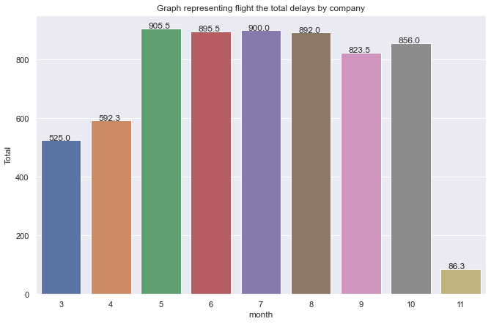
EDA
During the months of June, July, August, September, October and November, the majority of flights are made, June and August in particular,

Slide 13
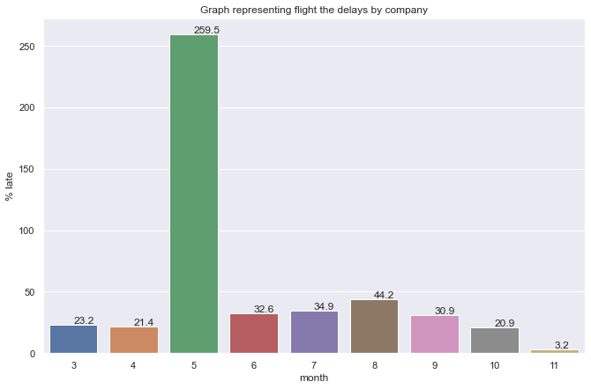
EDA
For the months that are far behind, we can clearly see that June is a champion, followed by August and July.

Slide 14
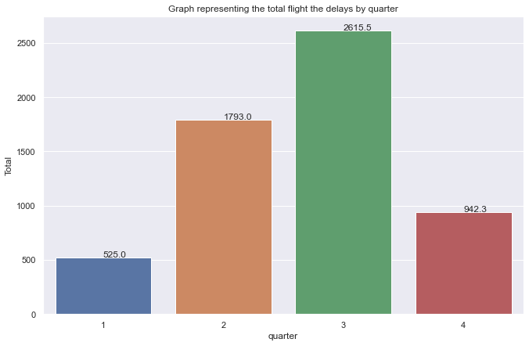
EDA
The third and second trimester are the two trismetres where there is a great peak of flight,

Slide 15
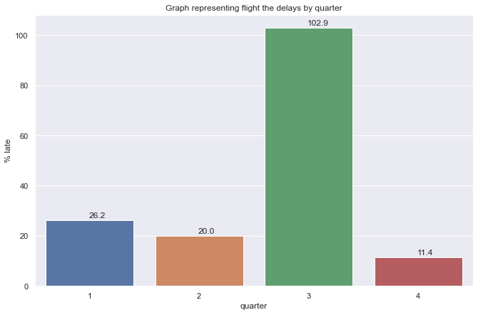
EDA
In theme of delay, the third trimester is in function of delay is crowned champion, it surpasses all the others.

Slide 16
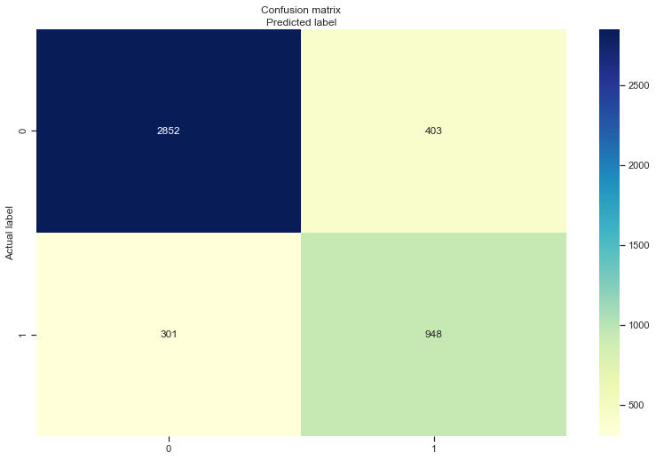
MODELING
In the confusion we can see that our prediction was right 2852 times predicting that there will be flight delays and it was wrong 403, for the predictions of no delay it is 301 times bad predictions against 948 times good predictions.

Slide 17
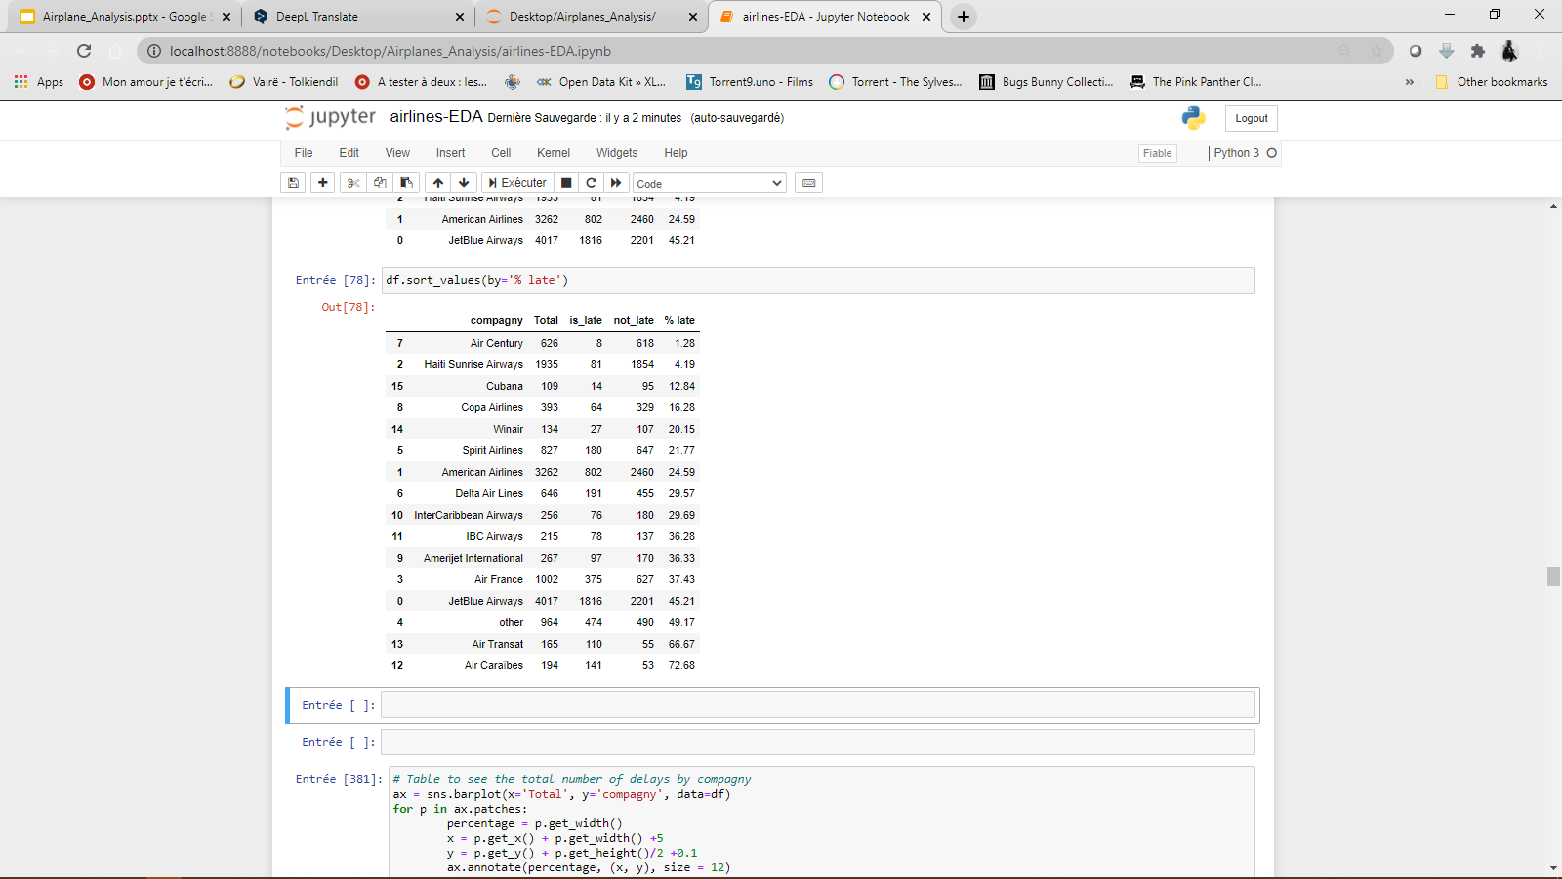
Conclusion
Here we can better see the figure of each company, according to their flights as well as their number of delays and the number of times they are on time.
Among the good students who are on time, Air Century, Haiti Sunrise Airways are the ones with the lowest percentage of delay, with respectively 1.28 and 4.2 and for the most delayed we have Air Caraibes, AIr Transat and JetBlue Airways.
JetBlue Airways and American Airlines have made a lot of flights but they have a very high number of delays.

Slide 18

See the link here : https://github.com/Shito3/Airplanes_Analysis
Thank you!

